Slide 1
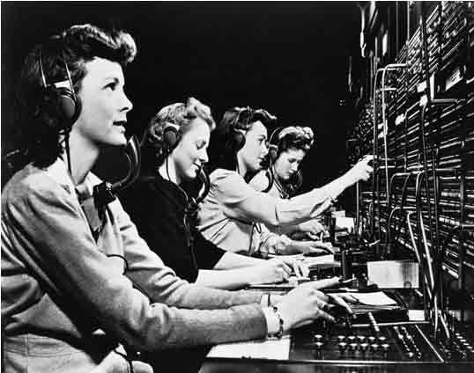
Operators

Slide 2
What is an operator?
Operators manipulate or evaluate data (operands)
Consider: 4 + 5
  4 and 5 are operands
  + is an operator

Slide 3
Types of operators
Arithmetic
Assignment
Comparison (relational)
Logical
Bitwise
Membership
Identity

